Slide 1




Final Project
www.zebe.ro
Author: Alexandra Cristea
Date: 27.11.2023

Slide 2

Agenda
Introduction
Testing Approach
Testing Tools
Testing Types and Testing Levels
Test Cases Overview
Test Cases Results
Bugs Overview
Conclusions and Lessons Learned

Slide 3


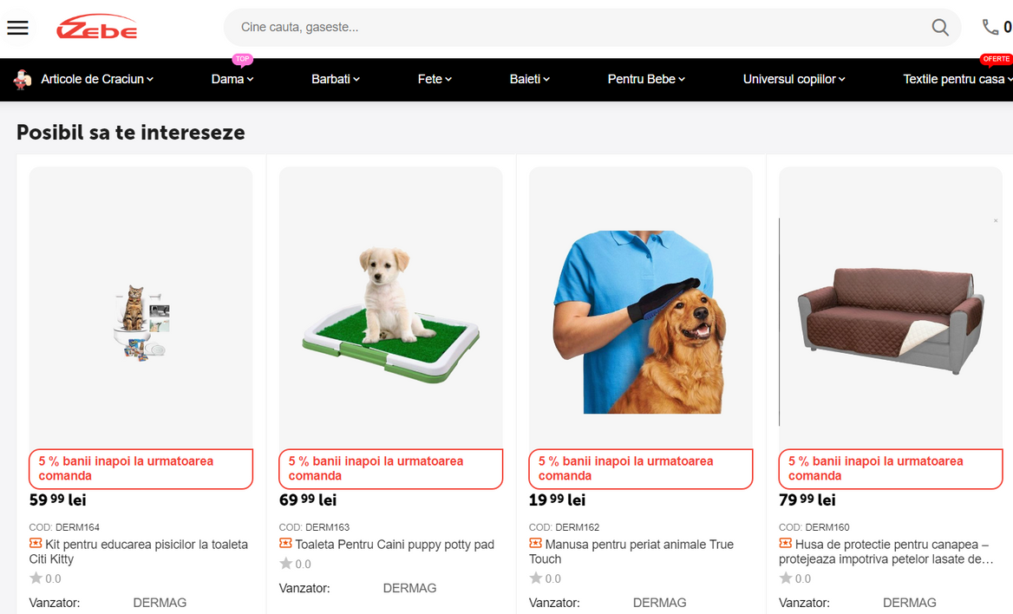
Introduction
Romanian e-commerce website
National distribution
Large variety of products
Buyer & Seller account types
Main functionalities: product catalog, user accounts, placing orders

Slide 4

Testing Approach
Perform exploratory testing
Design test cases and test data
Report identified bugs
01
03
05
07
02
04
06
Select a website
Test Planning
Perform test execution
Prepare a test report

Slide 5





Testing Tools
Test case design and Execution
Test Data,
Test Report
Bug Reporting
(Snipping Tool)
Screenshots
Project Presentation

Slide 6
Testing Types Used
Test case design and Execution
Test Data,
Test Report
Bug Reporting
(Snipping Tool)
Screenshots
Project Presentation

Slide 7
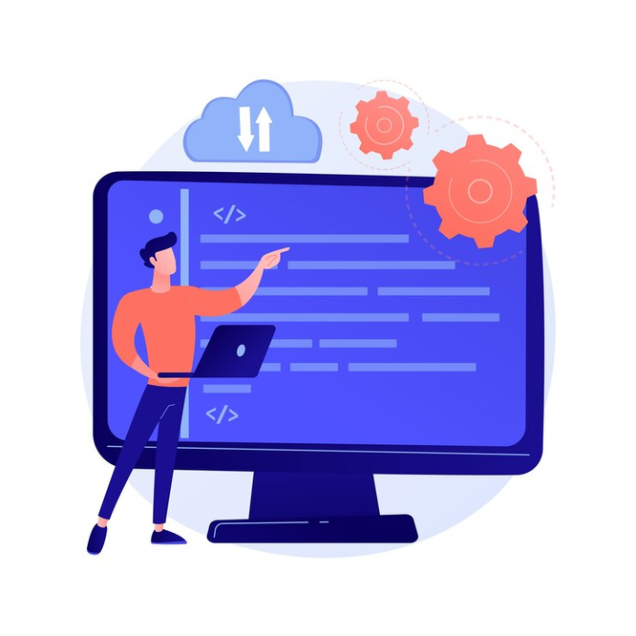
Testing Types Used
Smoke testing
Functional testing vs Non-functional testing
Black-box testing
Pozitive testing vs Negative testing
Exploratory testing
Dynamic testing
Usability testing

Slide 8
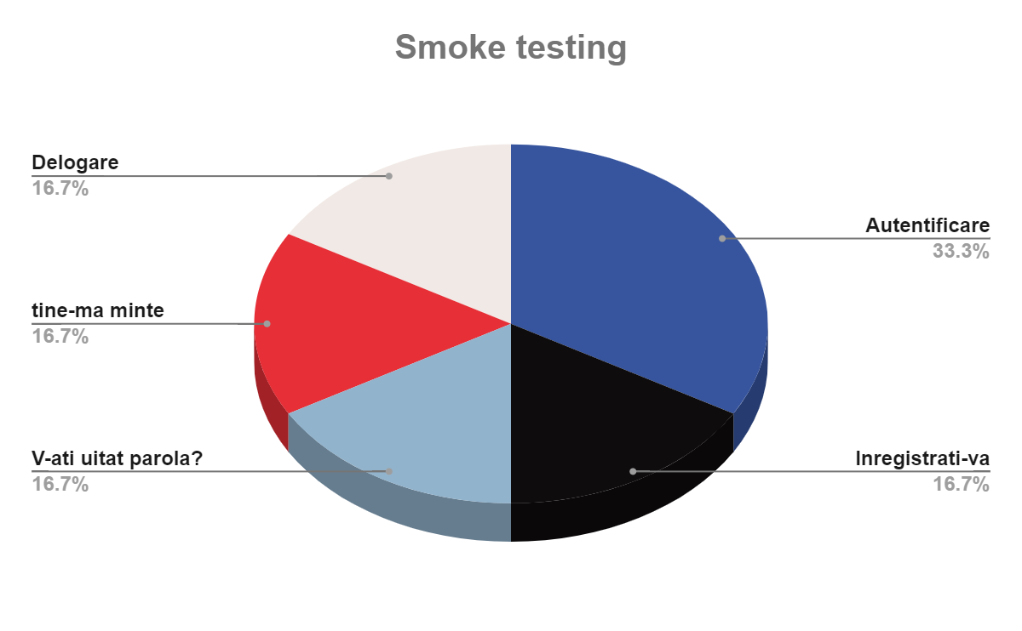

Slide 9
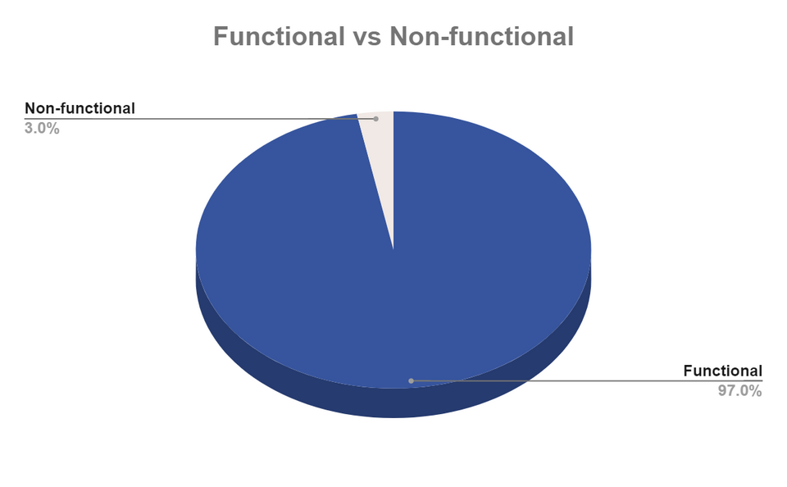
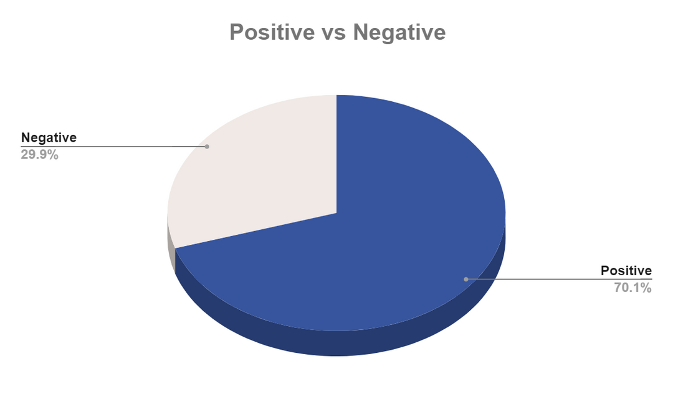
Test cases overview

Slide 10
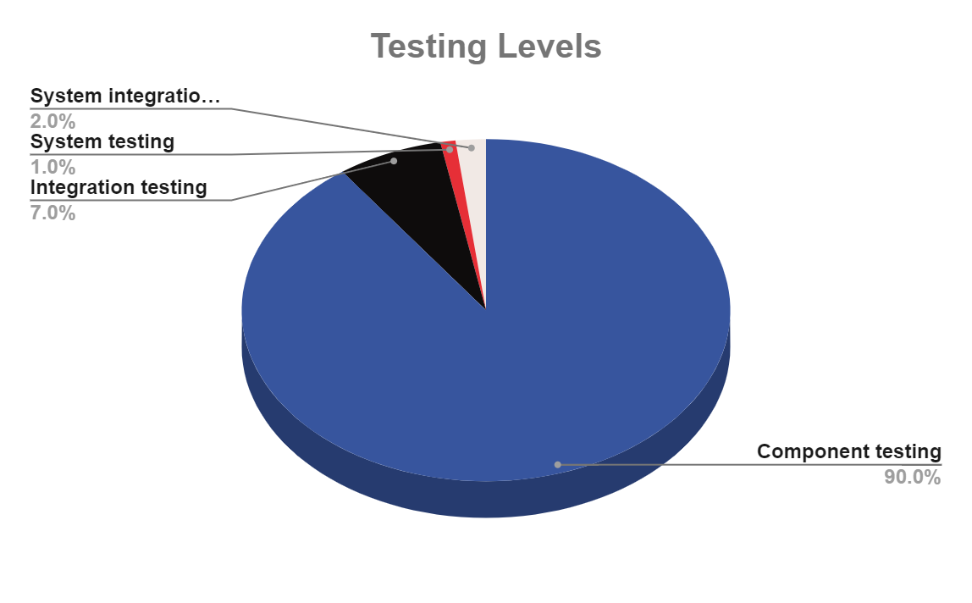

Slide 11
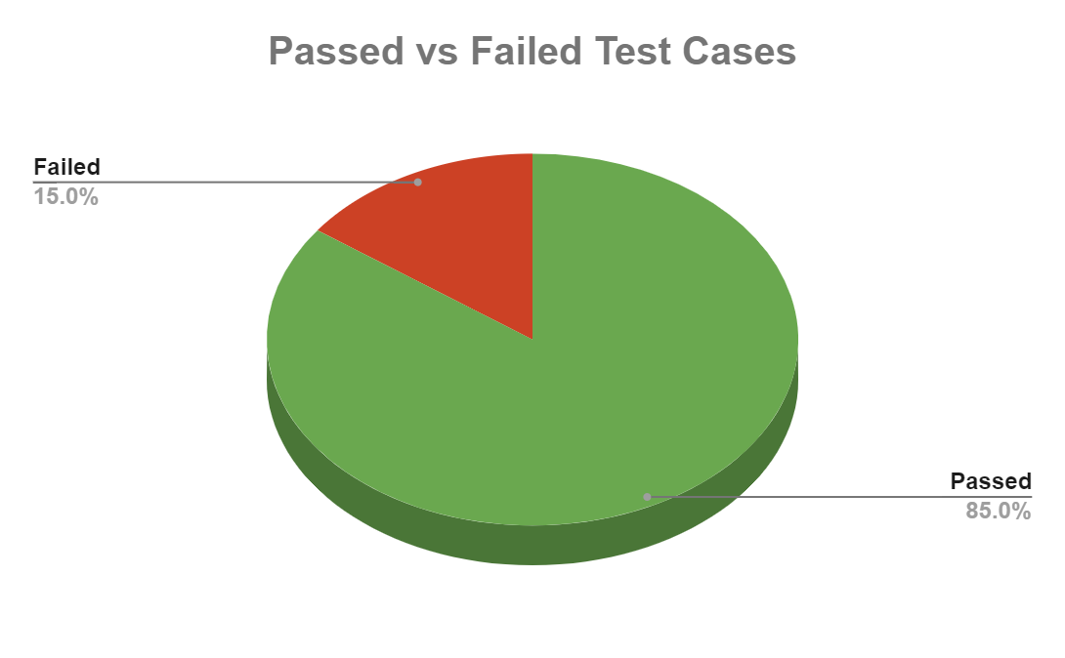

Slide 12
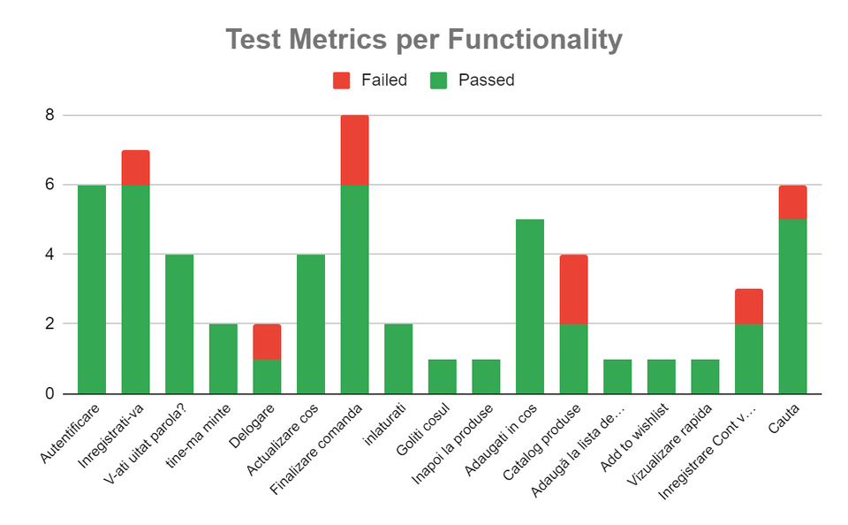
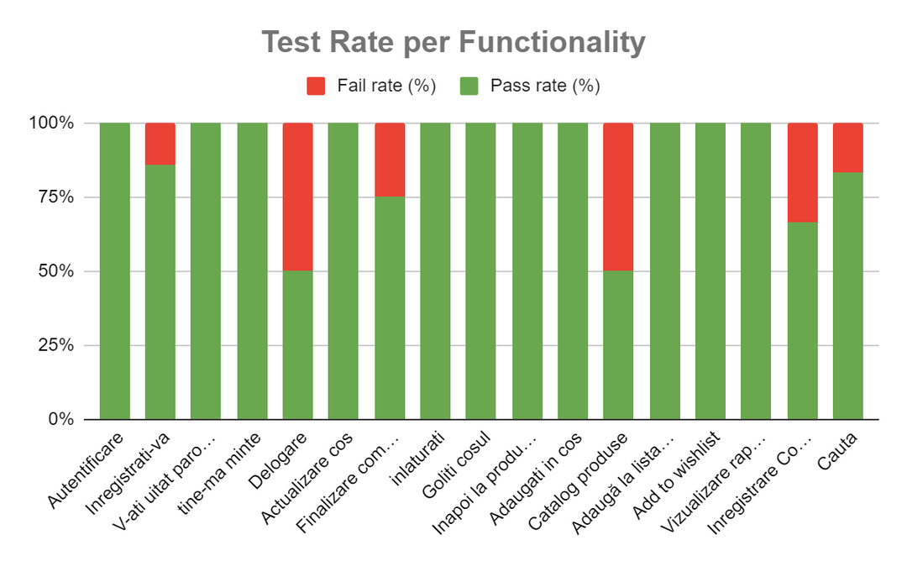
Test cases results

Slide 13
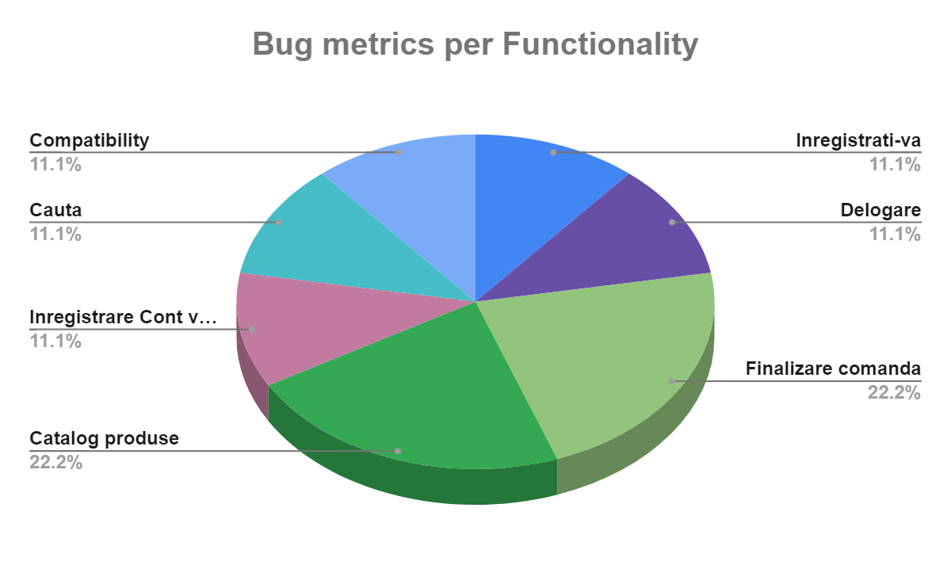
Bugs Overview

Slide 14
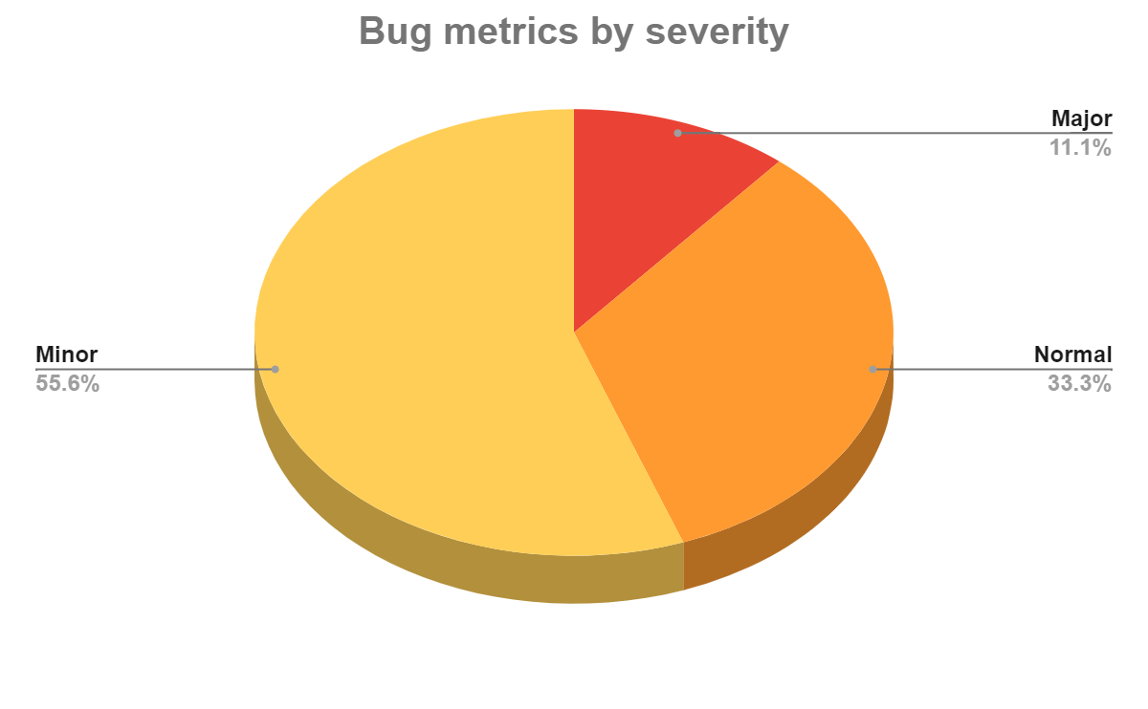

Slide 15
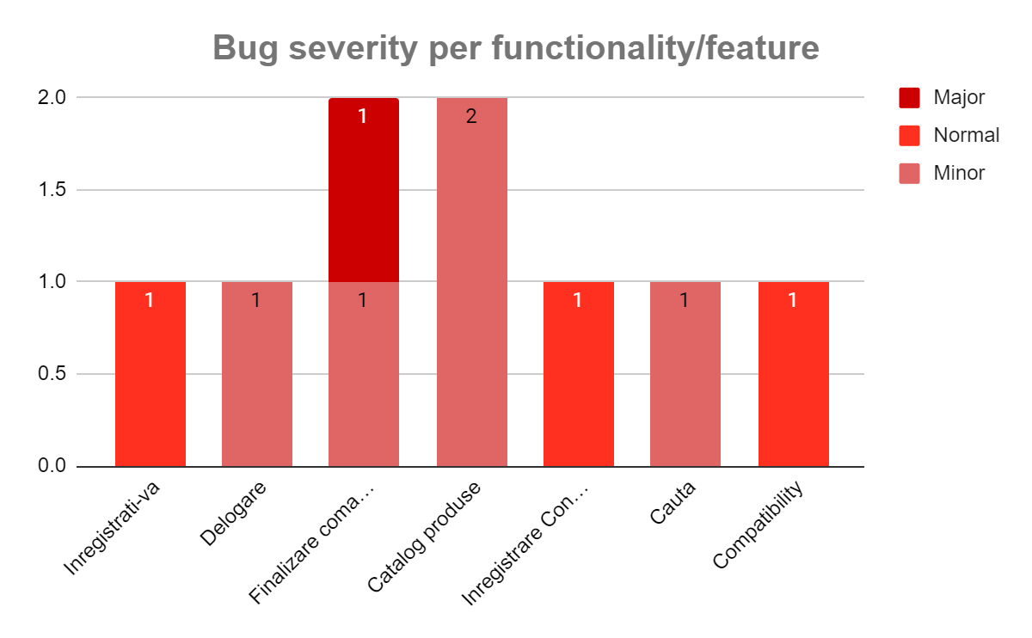

Slide 16

Conclusions
smoke testing session included 5 test cases which all have the status passed
during test execution 9 bugs were identified.
Terms and Conditions link error may erode trust, causing order abandonment
incorrect email registration can lead to login problems and user frustration.
visual and textual typos, create an unpleasant experience, potentially driving users to alternative websites

Slide 17

Lessons learned
Finding bugs without clear requirements may not really mean they're actual issues.
Giving precise details when reporting bugs helps developers comprehend and replicate the problem, resulting in quicker resolution.
Thorough testing, exploring different scenarios, improves product quality by catching and fixing issues before the release.
Even minor bugs can affect the user experience, potentially causing users to avoid the website.
It's crucial to always consider the user's perspective when testing a website or application.

Slide 18

Thank You

